Slide 1
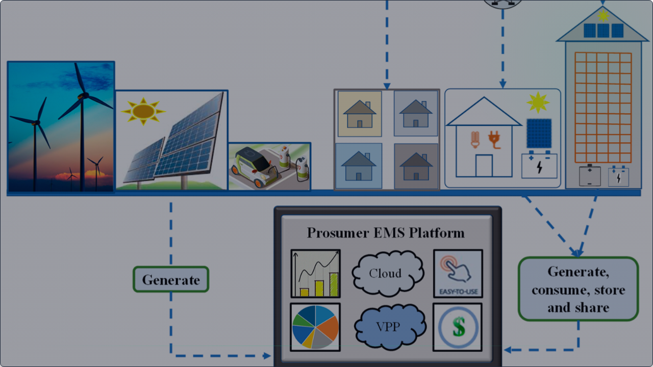

Smart IoT Solar Load Management
Voltage Stabilization and Demand-Side Control for Solar-Powered Micro-Grids

Slide 2







THE CRISIS OF MICRO-GRID INSTABILITY
Intermittency
Grid Collapse
All-or-Nothing
Unpredictable solar irradiance (cloud cover) causes severe voltage sags in localized grids.
Heavy non-essential loads cause current spikes during dips, tripping the entire system.
Standard protection shuts down power to the entire house indiscriminately, losing essential assets.
A critical gap exists for real-time edge computing to manage demand proactively.

Slide 3

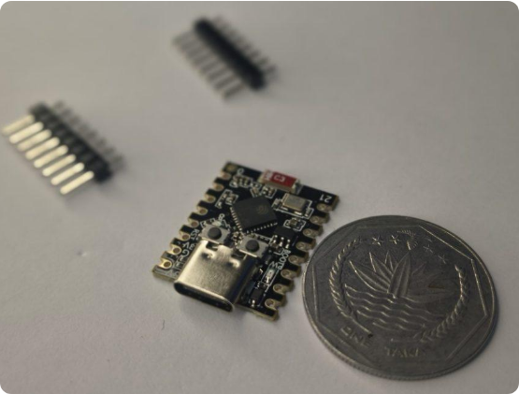
GRACEFUL DEGRADATION STRATEGY
The Intelligent Solution
Our proactive IoT framework utilizes Edge Computing to detect solar drops and segment demand within milliseconds.
→
Proactive Shedding: Disconnects non-essential loads (AC, Fridge) before the crash.
→
Critical Continuity: Ensures essential assets (Laptops, Fans) remain powered.
→
Net-Zero Wastage: Optimizes power utilization during generation fluctuations.
→
IoT Integration: Real-time monitoring and override via cloud dashboards.

Slide 4
SYSTEM ARCHITECTURE SPECIFICATIONS
Layer | Technical Selection | Function
Edge Logic | ESP32 WROOM-32 (240MHz) | Dual-core processing, real-time sensing, & IoT Wi-Fi handling.
Telemetry | ZMPT101B & ACS712 Sensors | Precise AC voltage and current sensing for sag detection.
Actuation | Opto-Isolated 4-Channel Relay | Safe electrical isolation & dynamic household load switching.
Software | Arduino IDE & Blynk IoT v2.0 | Embedded C++ priority logic and interactive cloud telemetry.
Protocol | ESP-NOW Wireless Mesh | Low-latency, high-speed peer-to-peer load synchronization.

Slide 5




ENGINEERING NOVELTY & INNOVATION
Edge Latency vs Cloud Delay
Localized Cost Efficacy
By executing priority allocation on-chip at the edge, the system responds within milliseconds, saving the grid before the current surge can trip master breakers.
Delivers industrial-grade Demand-Side Management for a fraction of the cost, making advanced grid resilience accessible for residential micro-grids.
INNOVATION: GRANULAR GRACEFUL DEGRADATION VS WHOLESALE SHUTDOWNS

Slide 6


IMAGE SOURCES
https://roborear.com/wp-content/uploads/2026/03/IMG_20260311_055219989_HDR_PORTRAIT-1-scaled-e1773187236469-1024x642.jpg
Source: roborear.com
https://www.mdpi.com/energies/energies-17-03100/article_deploy/html/images/energies-17-03100-g010.png
Source: www.mdpi.com

